Slide 1
SCM-651
Orange Juice Data Market Analysis
-Harsh Darji
-Rajat Varshney
-Lu Yin
-Mohammed Alnahdi

Slide 2
Agenda Style
01
Introduction
02
Business Questions
03
Descriptive Analysis and Modeling
04
Conclusion

Slide 3
Introduction

Slide 4
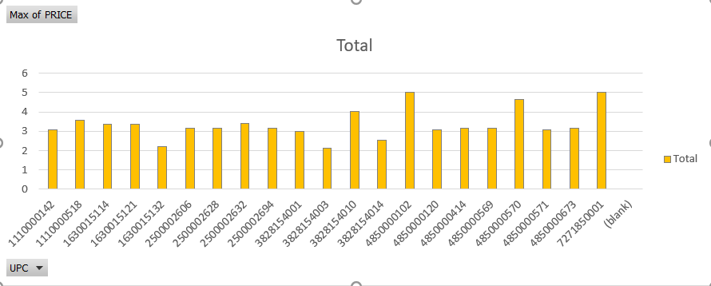
Selection of Data
Criteria:
Our goal is to include three UPC’s in our analysis with two higher priced national brands and one lower priced or store brand.
Pivot Chart Inference:
We have selected UPC 4850000102 and UPC’s 1110000142 for products with higher price and 1630015114 which are priced less.

Slide 5
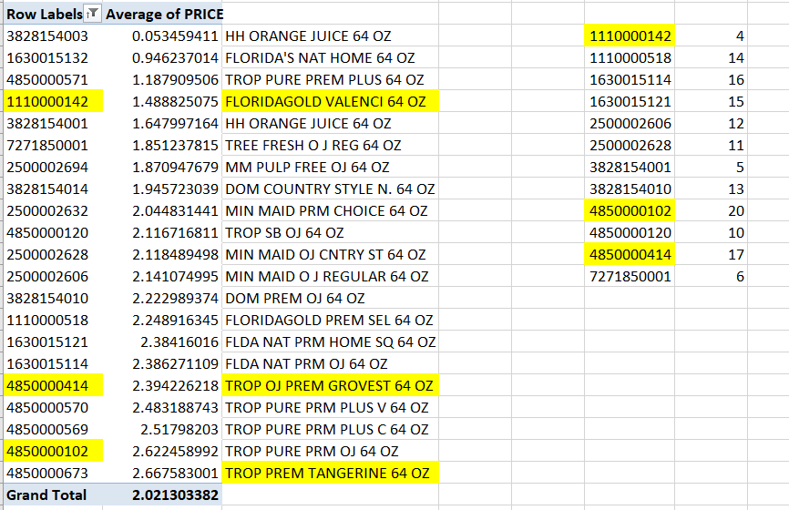
Selection of Data
Criteria:
Our goal is to include three UPC’s in our analysis with two higher priced national brands and one lower priced or store brand.
Pivot Chart Inference:
We have selected UPC 4850000102 which has highest priced. And UPC’s 1110000142 &
1630015114 which are priced less.

Slide 6
Business Questions

Slide 7
Business Questions
How does the proportion of times a brand is on sale vary across brands?
How does the demand for a brand depend on price? What is the price elasticity of demand of a brand?
How does the demand for a brand depend on the price of another brand?
Is price elasticity different for different brands?
What demographic factors affect demand?
How does demand depend on whether the product is on sale (Feat =1)? Is this dependence same for all brands?
How does price vary
across brands?
How does the demand for a brand or a product category vary over time?
Develop a model, and test how it performs on a validation sample.

Slide 8
Descriptive Analysis & Modeling

Slide 9
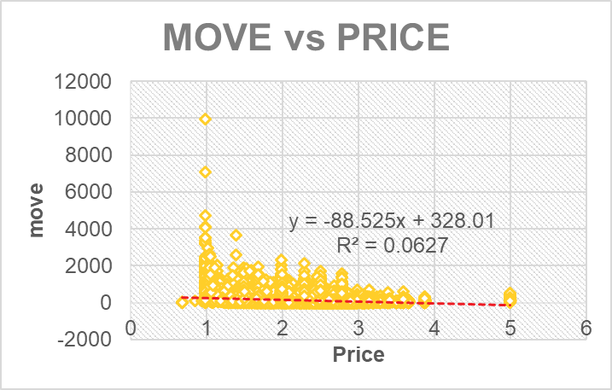
How does the demand for a brand depend on price? What is the price elasticity of demand of a brand?
From the scatter plot above we can conclude that as
Price goes on increasing the demand goes on
decreasing.

Slide 10
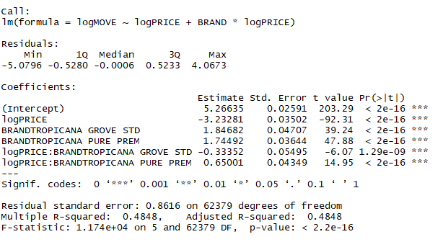
How does the demand for a brand depend on price? What is the price elasticity of demand of a brand?
After running a linear model, the price elasticity of demand of a brand was found to be:
TROPICANA GROVE STD: -3.56
TROPICANA PURE PREM: -2.58
FG: -3.23

Slide 11
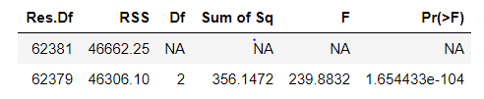
Is price elasticity
different for different
brands?
From the regression model, we conclude that the
price elasticity is different for different brands.
Supporting linear hypothesis.

Slide 12
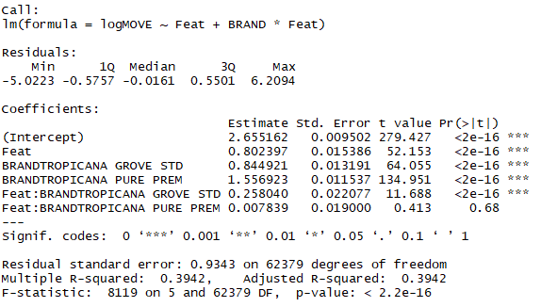

How does demand
depend on whether
the product is on
sale (Feat =1)? Is
this dependence
same for all brands?
Demand will increase when the product is on sale because all coefficients are positive. Based on hypothesis test, the coefficient of different brands are not equal.
Supporting linear hypothesis

Slide 13
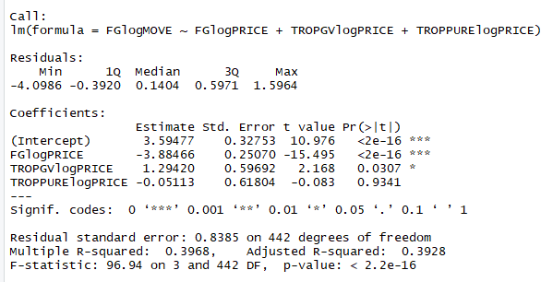
How does the demand for a brand depend on the price of another brand?
From the model above, we can conclude that the demand for FG is significantly depended on price of both FG and TROPGV. Our model shows that as price of FG increases demand tends to decrease and as price of TROPGV increases demand for FG begins to increase.

Slide 14
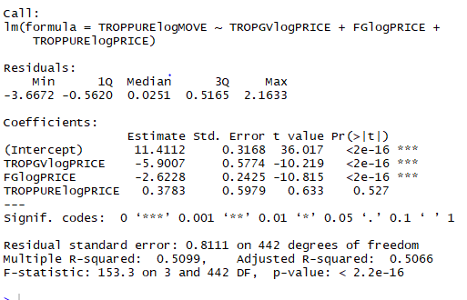
How does the demand for a brand depend on the price of another brand?
From the model above, we can conclude that the demand for TROPPURE is significantly depended on price of both FG and TROPGV. Our model shows that as price of FG increases demand tends to decrease and as price of TROPGV increases demand for FG begins to decrease.

Slide 15
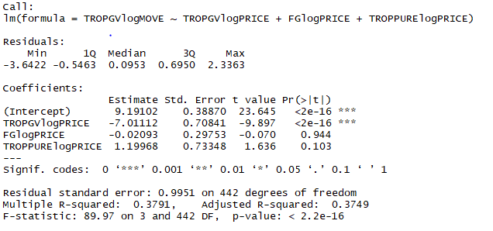
How does the demand for a brand depend on the price of another brand?
From the model above, we can conclude that the demand for TROPGV is significantly depended on its own price. While, price of FG and TROPOURE doesn’t have a great impact on demand of TROPGV. Our model shows as the price of TROPGV increases demand for TROPGV begins to decrease.

Slide 16
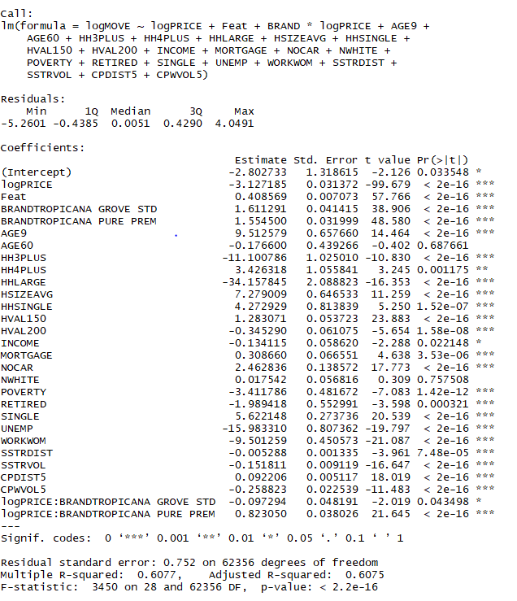
What
Demographic
factors affect demand?
From the regression model, we conclude that demographic factors that affect demand are : AGE9,HH3PLUS,HHLARGE,HSIZEAVG,HHSINGLE,HVAL150,HVAL200,MORTGAGE,NOCAR,POVERTY,RETIRED, SINGLE,UNEMP,WORKWOM,SSTRDIST,SSTRVOL,CPDIST5,CPWVOL

Slide 17
How does price vary across brands?
Row Labels | Average of logPRICE | Average of PRICE | StdDev of PRICE
FG VALENCIA | 0.711201866 | 2.075668098 | 0.404986774
TROPICANA GROVE STD | 0.913576135 | 2.523648221 | 0.365848245
TROPICANA PURE PREM | 0.974220452 | 2.695135144 | 0.491665959
Grand Total | 0.893993319 | 2.498983117 | 0.509072125
The above pivot table shows how the price varies across brands.
The average price for FG Valencia is 2.0756 while for Tropicana Grove and Tropicana Pure average price is slightly higher.

Slide 18
How does the
proportion of times a brand is on sale
vary across brands?
Sum of logMOVE | Column Labels
Row Labels | 0 | 1 | Grand Total
FG VALENCIA | 55.46% | 44.54% | 100.00%
TROPICANA GROVE STD | 60.46% | 39.54% | 100.00%
TROPICANA PURE PREM | 61.37% | 38.63% | 100.00%
Grand Total | 60.06% | 39.94% | 100.00%
The above pivot chart shows that:
FG Valencia has almost equal proportion whether it’s on sale or not.(1:1ratio)
While, for Tropicana Grove and Tropicana Pure the ratio is (3:2).

Slide 19
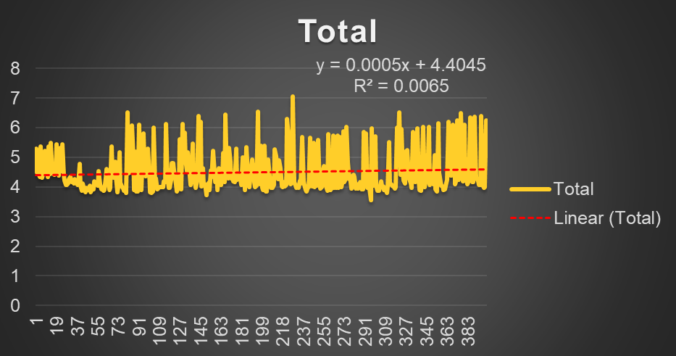
How does the
demand for a brand or a
product category
vary over time?
The trend line in our scatter plot sows that the
demand is relatively constant across a longer span of time.

Slide 20
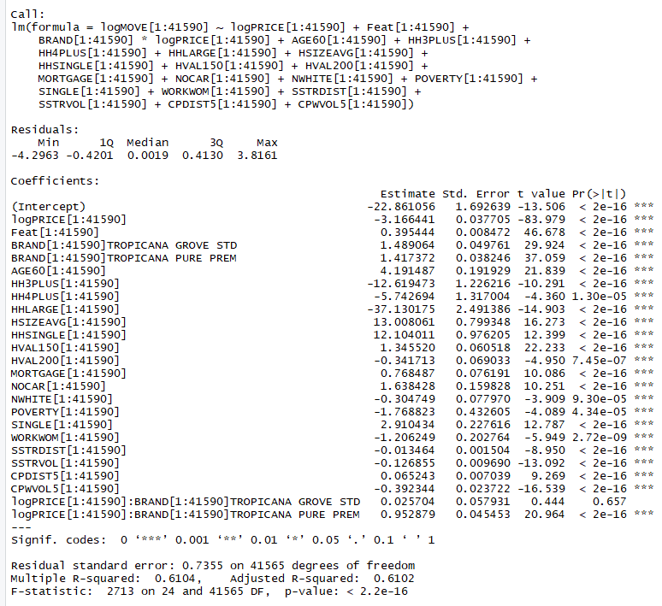
Develop a model,
and test how it
performs on a
validation sample.
Our final model shows that adjusted R-squared value is 0.6102 which is significantly higher than the full model. Also, P-value indicates that all the variables are significant in predicting the demand.

Slide 21
Conclusion

Slide 22
Conclusion
All the business questions were answered using regression model and supporting graphs and charts.
We understood and implemented models indicating
relationship between demand and prices of various brands in our data.
We executed model to find the impact of demographic factors on demand of a brand.
We created a new model considering significant variables which is more superior than our previous model and has a higher predictive ability.

Slide 23
Thank You

